Slide 1
USCG Application for Private Aids to Navigation
ENVE F644 Spring 2020
MaLinda Malenfant

Slide 2
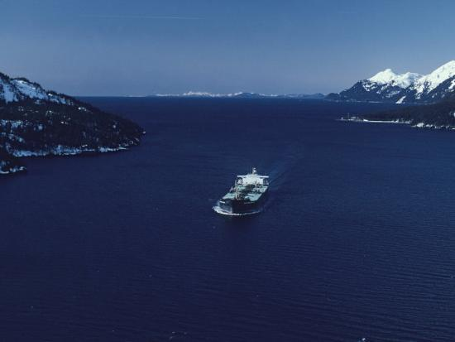
33 CFR Part 66 - Private Aids to Navigation
Code of Federal Regulations
PURPOSE
Private Aids to Navigation (PATON) refers to all marine aids to maritime navigation in the federally recognized waters of the US
EXAMPLES OF AID
Lighted structures
Day beacons
Lighted and unlighted buoys
Fog signals
EXCLUDING
Any PATON operated in State waters or operated by the Federal Government.

Slide 3
PATON
Non-commercial, single boat, mooring buoys
Swim buoys
No wake buoys
Race course buoys
*most things that have “minimal adverse effect” on navigation and display all appropriate markings, or that are informational*
EXCLUSIONS

Slide 4
Application Process
§ 66.01-5 Application procedure.
To establish and maintain, discontinue, change, or transfer ownership of a private aid to navigation, you must apply to the Commander of the Coast Guard District in which the aid is or will be located. You must complete all parts of the form applicable to the aid concerned, and must forward the application to the District Commander. You must include the following information:
(a) The proposed position of the aid to navigation by two or more horizontal angles, bearings and distance from charted landmarks, or the latitude and longitude as determined by GPS or differential GPS. Attach a section of chart or sketch showing the proposed position.

Slide 5
Application Process Cont.
(b) The name and address of the person at whose expense the aid will be maintained.
(c) The name and address of the person who will maintain the aid to navigation.
(d) The time and dates during which it is proposed to operate the aid.
(e) The necessity for the aid.
(f) For lights: The color, characteristic, range, effective intensity, height above water, and description of illuminating apparatus. Attach a copy of the manufacturer's data sheet to the application.

Slide 6
Application Process Cont.
(g) For sound signals: Type (whistle, horn, bell, etc.) and characteristic.
(h) For buoys or daybeacons: Shape, color, number, or letter, depth of water in which located or height above water.
(i) For AIS AtoN and racons: Manufacturer and model number of AIS AtoN and racon, position and height above water of desired installation, and requested MORSE coding or AIS AtoN message characteristics. Equipment must have FCC authorization.
*beacons installed on navigational hazards, radar beacons, Federal Communications Commision*

Slide 7
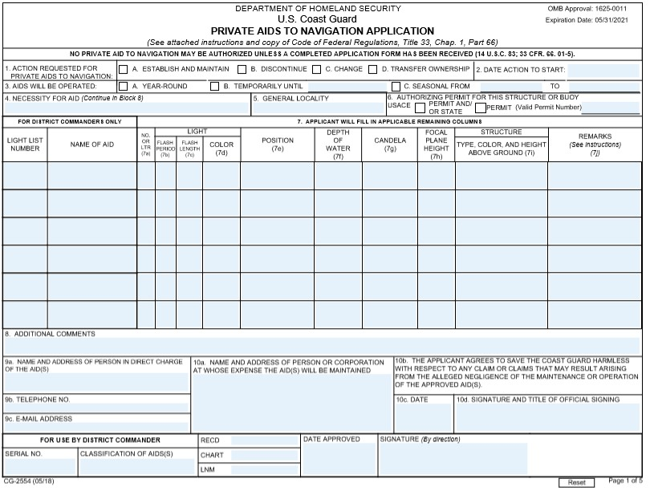

Slide 9
Quick Facts:
Permit issued by United States Coast Guard
No cost to apply
Required for installation of fixed structure or floating object in navigable waters of US
Expect average wait time of 3 months for approval
Permit is valid forever, unless change in ownership, dock location, or removal
Any appeals can be made in writing to 13th District Coast Guard Commander
Other related Parts
Title 33 CFR Part 62 - United States Aids to Navigation System
Title 33 CFR Part 64 - Marking of Structures, Sunken Vessels and other Obstructions
Title 33 CFR Part 67 - Aids to Navigation on Artificial Islands and Fixed Structures
Title 33 CFR Part 66 - Private Aids to Navigation

Slide 10
Approvals
Any fixed structures are altered or placed in the navigable waters of the US, the US Army Corps of Engineers , District Engineer must be notified and approve of the aid.
Then the Commandant of the United States Coast Guard for your specific location must be notified and approve the before mentioned application, in all cases except the exceptions.
*The Corps only has to approve fixed structures*

Slide 11
Existing structures
§ 66.01-40 Exemptions.
(a) Nothing in the preceding sections of this subpart shall be construed to interfere with or nullify the requirements of existing laws and regulations pertaining to the marking of structures, vessels and other obstructions sunken in waters subject to the jurisdiction of the United States (Part 64 of this subchapter), the marking of artificial islands and structures which are erected on or over the seabed and subsoil of the Outer Continental Shelf (Part 67 of this subchapter), or the lighting of bridges over navigable waters of the United States (Subchapter J of this subchapter)

Slide 12
Protection
§ 66.01-50 Protection of private aids to navigation.
Private aids to navigation lawfully maintained under these regulations are entitled to the same protection against interference or obstruction as is afforded by law to Coast Guard aids to navigation (Part 70 of this subchapter). If interference or obstruction occurs, a prompt report containing all the evidence available should be made to the Commander of the Coast Guard District in which the aids are located.
If report is sent, penalties may be made by the Coast Guard to the appropriate parties.

Slide 13
Thank you
Questions?

Slide 14
https://www.allposters.com/-sp/Oil-Tanker-Passes-Through-Valdez-Narrows-with-Chugach-Mountains-Posters_i3990370_.htm
https://www.carbonbrief.org/ocean-data-upgrade-confirms-pace-of-recent-warming
Pictures used

Slide 15
Works cited
https://www.navcen.uscg.gov/pdf/AIS/CG_2554_Paton.pdf
https://www.law.cornell.edu/cfr/text/33/part-66
https://www.law.cornell.edu/cfr/text/33/66.01-50
https://apps.oria.wa.gov/permithandbook/permitdetail/98

